Slide 1
List Comprehension – the Pythonic way
num = [1,2,3,4,5]
result = []
for item in num:
result.append(item * 2)

Slide 2
\
num = [1,2,3,4,5]
result = []
for item in num:
result.append(item * 2)
# result [2, 4, 6, 8, 10]

Slide 3
\
result = [ item * 2 for item in [1,2,3,4,5]]
# result [2, 4, 6, 8, 10]

Slide 4

List Comprehension – Syntax
[
expression
for
item
in
iterable
if condition
]

Slide 5
\
[
expression
for
item
in
iterable
if condition
]
item * 2

Slide 6
\
[
expression
for
item
in
iterable
if condition
]
item * 2
[1,2,3,4,5]

Slide 7
\
[
expression
for
item
in
iterable
if condition
]
item * 2
[1,2,3,4,5]
item > 1

Slide 8
\
[
expression
for
item
in
iterable
if condition
]
item * 2
[1,2,3,4,5]
item > 1
# result [4, 6, 8, 10]

Slide 9
Inline condition
can_vote = False
age = 25
if age > 17:
can_vote = True
else:
can_vote = False

Slide 10
\
can_vote = False
age = 25
if age > 17:
can_vote = True
else:
can_vote = False
# can_vote True

Slide 11
\
age = 25
can_vote = True if age > 17 else False
# can_vote True

Slide 12
Inline condition - Syntax
truthy
if
condition
else
falsy

Slide 13
\
truthy
if
condition
else
falsy
can_vote =
True

Slide 14
\
truthy
if
condition
else
falsy
can_vote =
True
age > 17

Slide 15
\
truthy
if
condition
else
falsy
can_vote =
True
age > 17
False

Slide 16
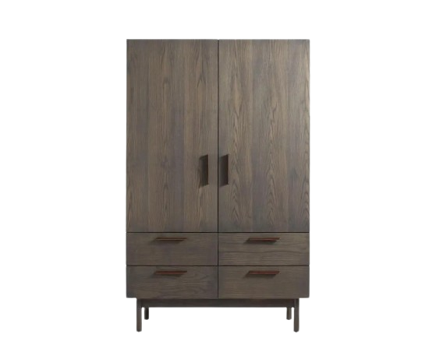

List vs Iterator

Slide 17
List

Slide 18



\

Slide 19
\

Slide 20
\

Slide 21
\

Slide 22
Iterator

Slide 23

\

Slide 24
\

Slide 25
\

Slide 26
\

Slide 27
\

Slide 28
\
Buy more cloth!

